Slide 1
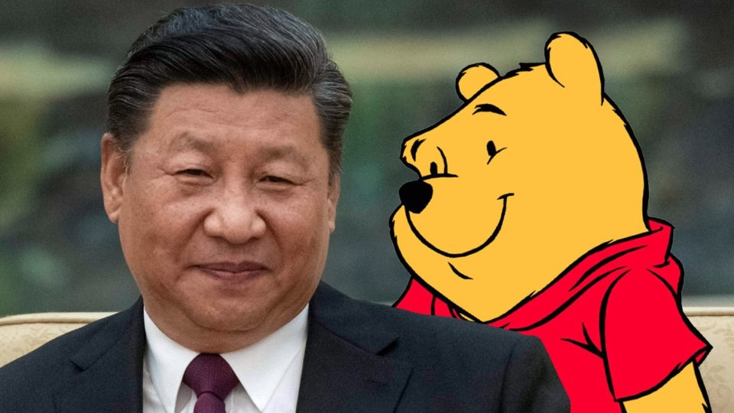
China
Notes:
It’s really old..

Slide 2
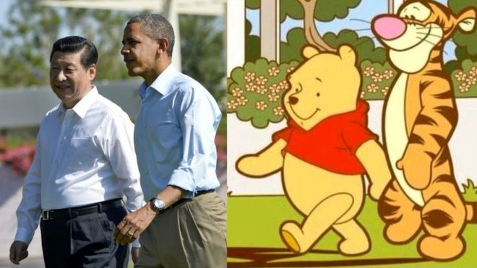
Government
-unicameral legislature: Xi Jinping President (unlimited 5yr terms)
-1 party; communist (National People’s Congress)

Slide 3
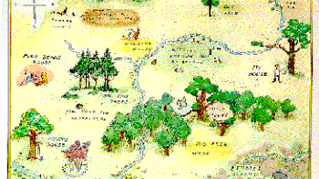
Geography
-Is one of the biggest countries by land mass
-It also has a abundance of reasorces

Slide 4
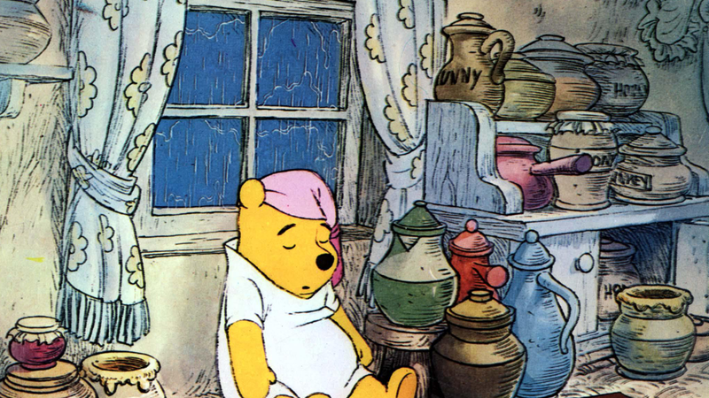
History
-communist revolution 1949, Mao comes to power (after 1911 revolution led by Yuan Shikai)
-great leap forward
-cultural revolution
-Deng 1980s; 4 modernizations & opening china up to Capitalism

Slide 5
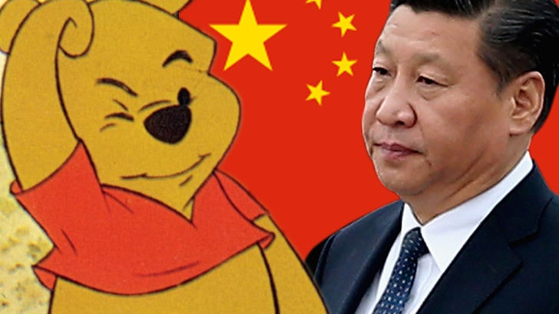
People and Society
-Population 1,384,688,986
-2015 Legislation allows 2 kids
-Most people work in Industrial jobs

Slide 6
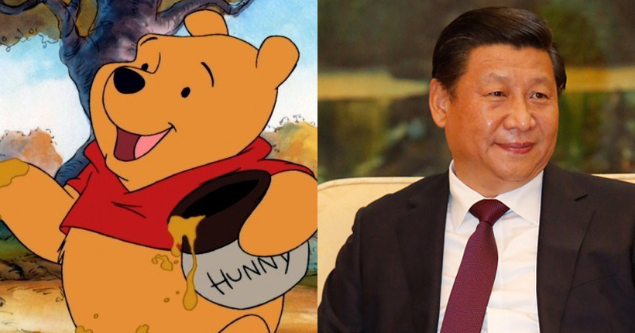
Economy
-Largely Tech based
-Little to zero worker rights
-Leaders in gross value of industrial outputs

Slide 7
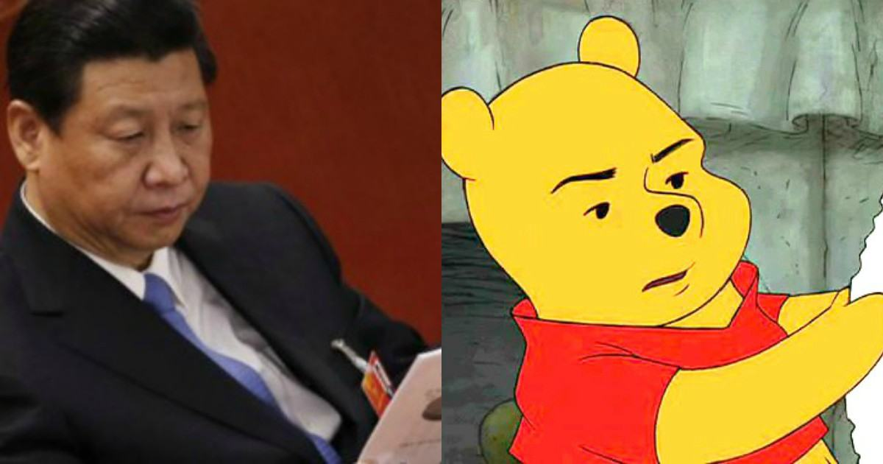
Trade war

Slide 9
Who Doesn’t love winnie the pooh

